Slide 1

COACHELLA MUSIC FEST
– RANISHREE ANEGUNDI

Slide 2
AGENDA
2
Introduction
ER Diagram
Entities and Attributes
Relationship Instances
Database Tables
SQL Commands
Mathematical Notations
Conclusion

Slide 3

INTRODUCTION

Slide 4
4
Coachella is an iconic annual music and arts festival in Indio, California.
It features a diverse lineup of rock, indie, hip-hop, and electronic dance music.
Music artists perform every year and over 20k people attended for the first time.
The main purpose is to celebrate the different genres of music.

Slide 5
ER DIAGRAM

Slide 6
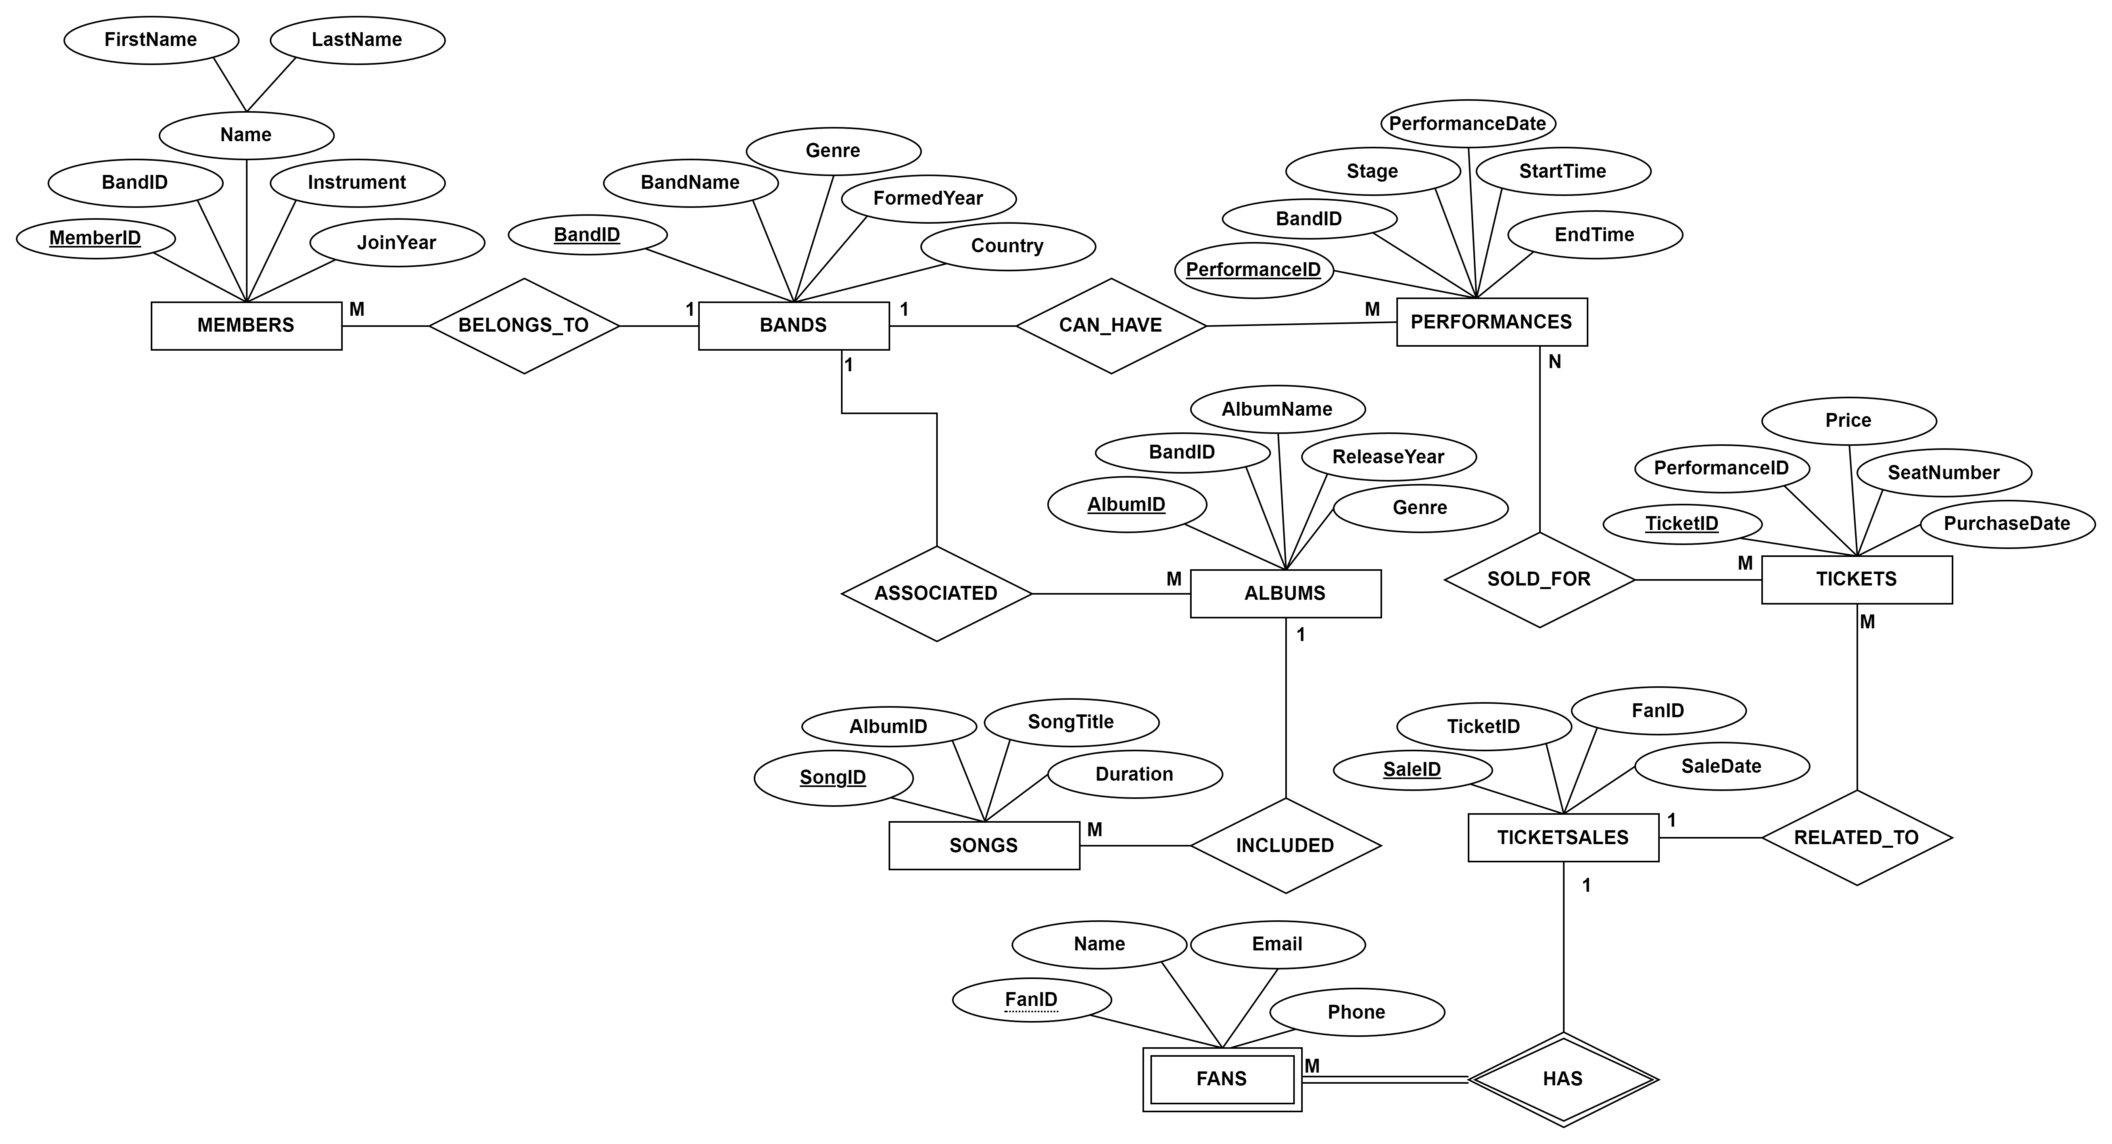
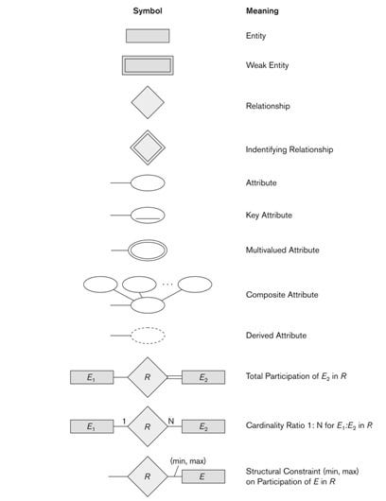
LEGEND

Slide 7
ENTITIES AND ATTRIBUTES

Slide 8
Bands: Represents musical bands with attributes for identification, genre, formation year, country, and more.
Members: Contains information about band members, linking each member to a specific band and detailing their role and join year.
Albums: Stores details of albums released by bands, including the album name, release year, and genre.
Songs: Includes data on individual songs within albums, such as title and duration, and associates them with their respective albums.

Slide 9
Performances: Records the live performances of bands, specifying the stage, date, and time of each performance.
Tickets: Tracks tickets sold for performances, including price, seat number, and purchase date.
Fans: Contains information about fans who attend performances, with details like name, email, and phone number.
TicketSales: Records the sale transactions of tickets, linking tickets to fans and sale date

Slide 10
RELATIONSHIP INSTANCES

Slide 11
Members belong to Bands (N:1 Relationship)
Bands has Fans (M:N Relationship)
Songs included in Albums (N:1 Relationship)
Performances given by Bands (N:1 Relationship)
Tickets sold for Performances (N:1 Relationship)
Performances associated with Fans (M:N Relationship)
TicketSales related to Tickets (N:1 Relationship)

Slide 12
DATABASE TABLES

Slide 13
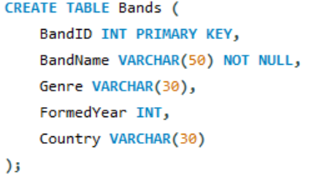
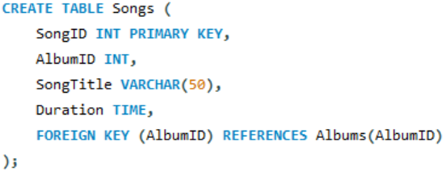
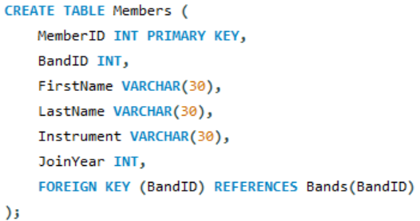
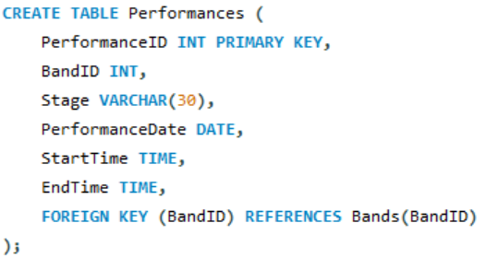

Slide 14
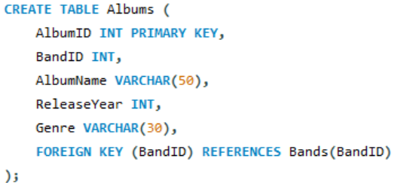
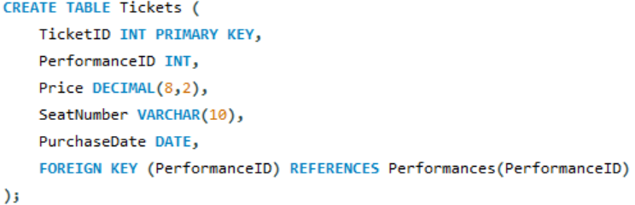
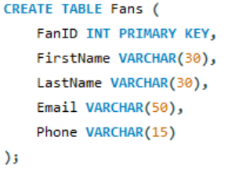
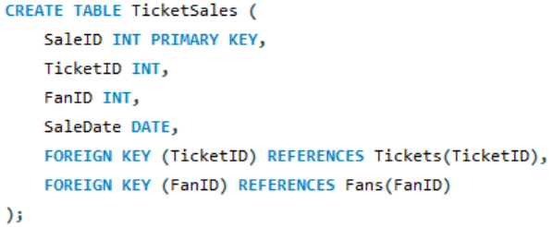

Slide 15
SQL BASIC COMMANDS

Slide 16
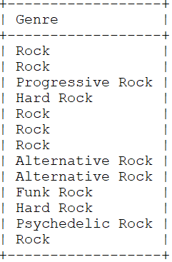
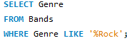
Find All Bands with "Rock" in Their Genre

Slide 17
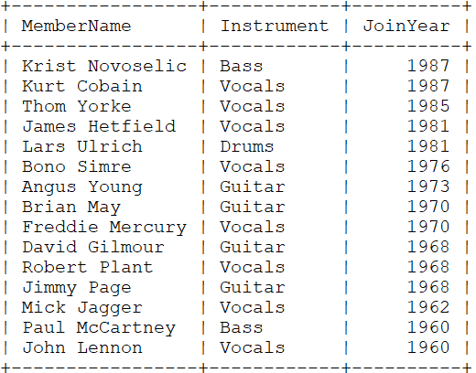
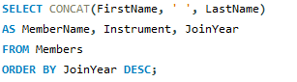
Retrieve Band Member Names, Instruments, and Join Year Ordered by Join Year Descending

Slide 18
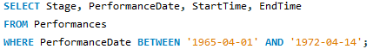
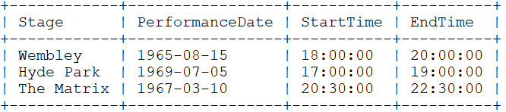
Retrieve Performance Details for Performances from 1965-1972 April

Slide 19
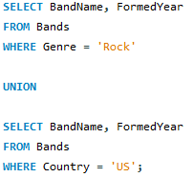
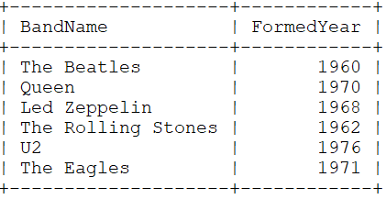
Retrieve Band Names and Formation Years for Rock Genre Bands or Bands from the United States

Slide 20
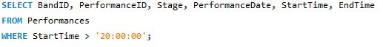
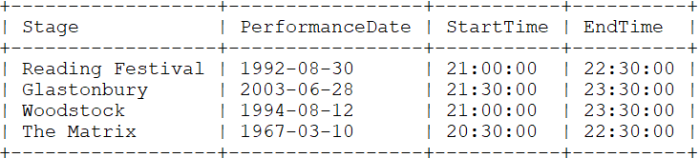
Retrieve Performances Starting After 8:00 PM

Slide 21
SQL INTERMEDIATE COMMANDS

Slide 22
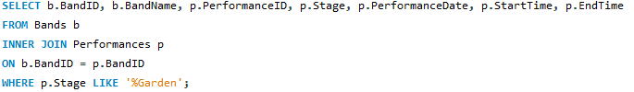
Retrieve Band and Performance Details for Stages Ending with 'Garden

Slide 23
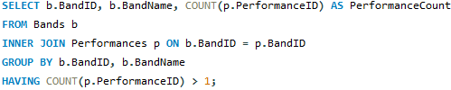
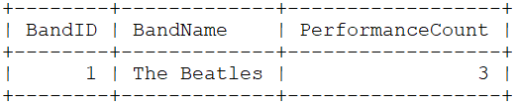
Display All Bands with Performance Count Greater Than 1

Slide 24
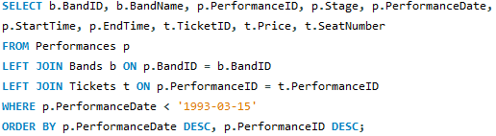
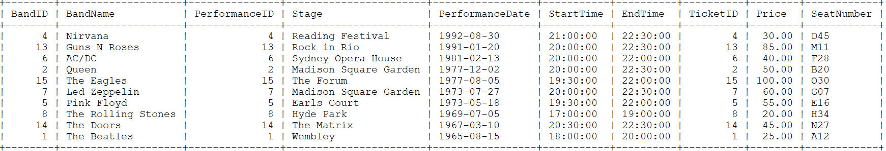
Retrieve Performance and Ticket Details for Performances Before March 15, 1993

Slide 25
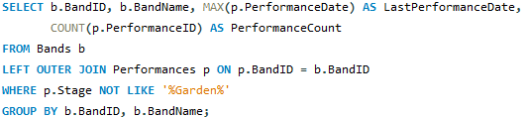
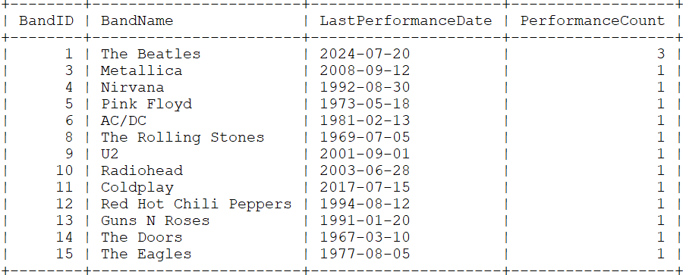
Retrieve Distinct Bands with Last Performance Date and Total Performance Count Excluding 'Garden' Stages

Slide 26
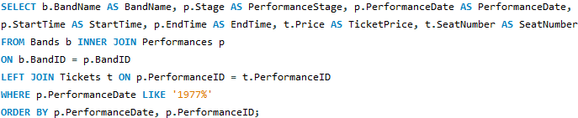
Retrieve Band and Performance Details for Performances in 1977 with Ticket Information

Slide 27
SQL ADVANCED COMMANDS

Slide 28
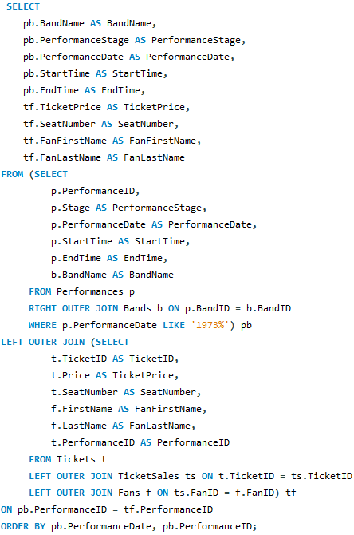
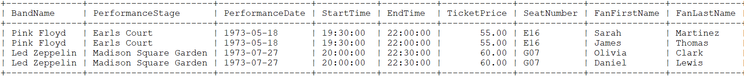
Retrieve Performance, Ticket,
and Fan Details for Performances
in 1973

Slide 29
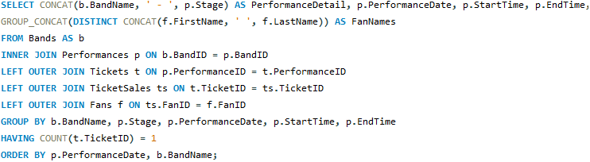
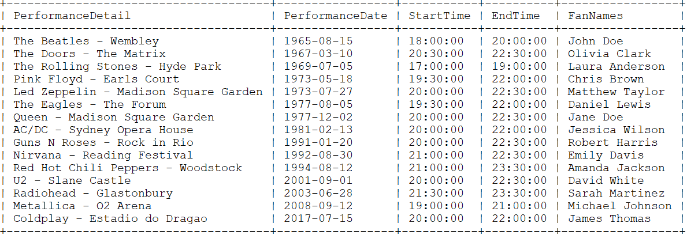
Retrieve Performance Details and Fan Names for Performances with Exactly One Ticket Sold

Slide 30
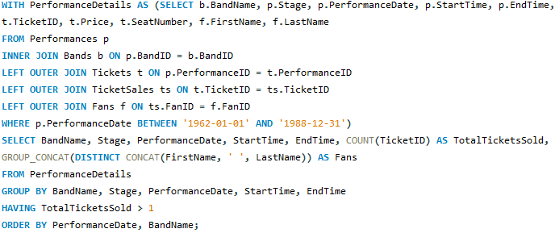
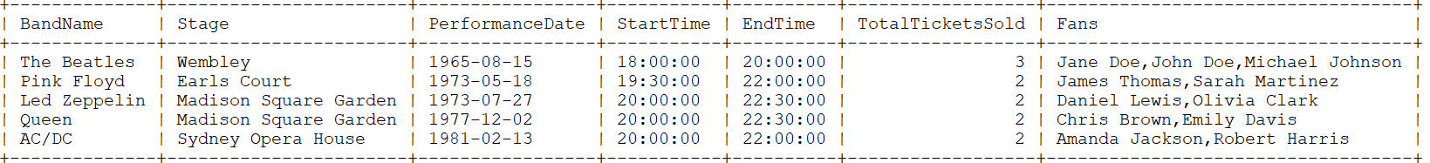
Performance Summary with Ticket Sales and Fan Details for Performances Between 1962 and 1988

Slide 31
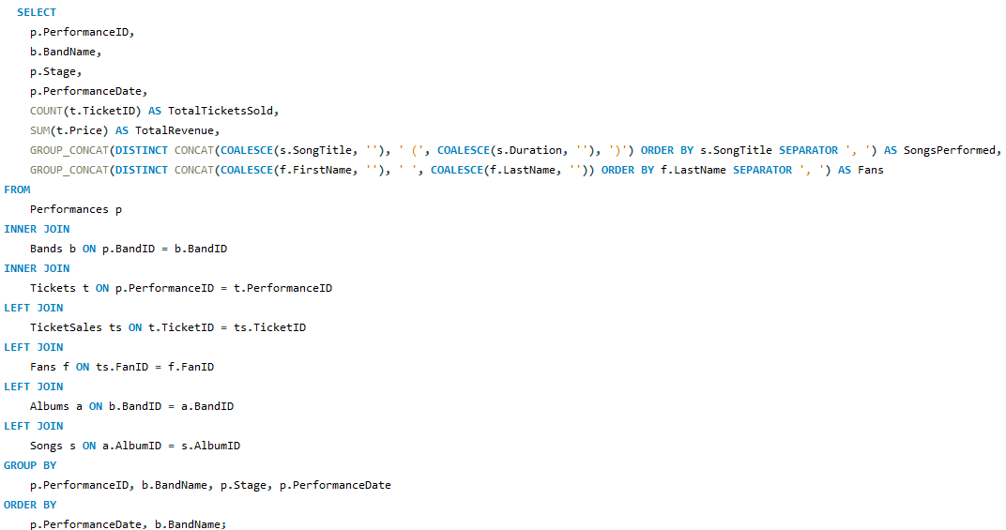
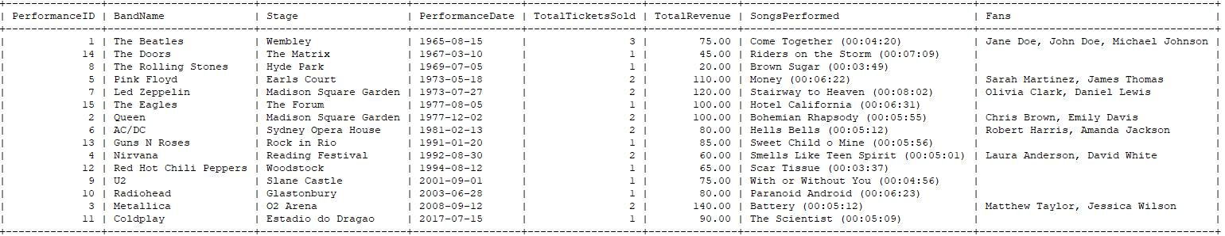
Performance Overview with Ticket Sales, Revenue, and Attending Fans

Slide 32
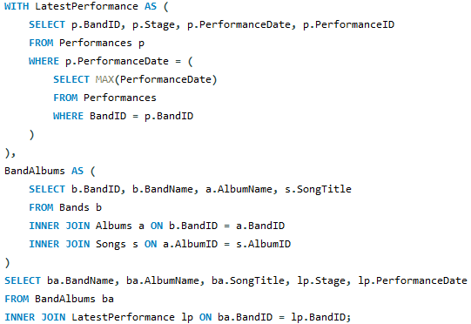
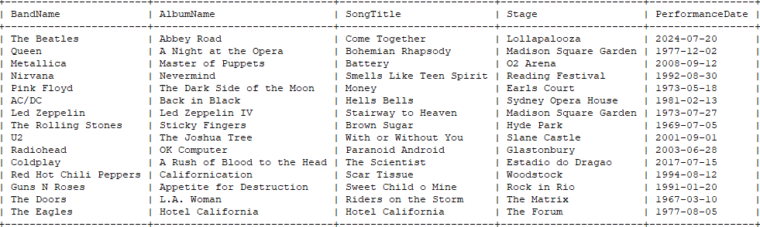
Latest Performances with Band Albums and Songs

Slide 33
BASIC MATHEMATICAL NOTATION

Slide 34
Find All Bands with "Rock" in Their Genre
σ_{Genre LIKE ′%Rock′​}(Bands)
π_{Genre}​(σ_{Genre LIKE ′%Rock′​}(Bands))
Result ← π_{Genre}​(σ_{Genre LIKE ′%Rock′​}(Bands))

Slide 35
Retrieve Band Member Names, Instruments, and Join Year Ordered by Join Year Descending
πMemberName = CONCAT(FirstName, ’ ’, LastName),Instrument,JoinYear​(Members)
Temp = πMemberName, Instrument, JoinYear​(Members)
Result ← τ_{JoinYear DESC}​(Temp)
* τ - Order By

Slide 36
Retrieve Performance Details for Performances from 1965-1972 April
Temp ← σPerformanceDate≥’1965-04-01’∧PerformanceDate≤’1972-04-14’​(Performances)
Result ← πStage,PerformanceDate,StartTime,EndTime​(Temp)

Slide 37
Retrieve Band Names and Formation Years for Rock Genre Bands or Bands from the United States
Temp1 ← π_{BandName,FormedYear}​(σ_{Genre=’Rock’}​(Bands))
Temp2 ← ​π_{BandName,FormedYear} (σ_{Country=’US’​}(Bands))
Result ← Temp1 ∪ Temp2

Slide 38
Retrieve Performances Starting After 8:00 PM
Temp ← σ_{StartTime>’20:00:00’​}(Performances)
Result ← πBandID,PerformanceID,Stage,PerformanceDate,StartTime,EndTime​(Temp)

Slide 39
INTERMEDIATE MATHEMATICAL NOTATION

Slide 40
Display All Bands with Performance Count Greater Than 1
Temp ← Bands⋈Bands.BandID=Performances.BandID​Performances
GroupedTemp ← γBandID,BandName,COUNT(PerformanceID)​(Temp)
Result ← σ_{PerformanceCount>1}​(GroupedTemp)
πBandID,BandName,PerformanceCount​(Result)
* γ - Group By

Slide 41
Retrieve Band and Performance Details for Performances in 1977 with Ticket Information
Temp1 ← Bands⋈Bands.BandID=Performances.BandID​Performances
Temp2 ← Temp1⟕Tickets ON Temp1.PerformanceID=Tickets.PerformanceID
Temp3 ← σ_{PerformanceDate LIKE ’1977%’}​(Temp2)
Temp4 ← πBandName,PerformanceStage,PerformanceDate,StartTime,EndTime,TicketPrice,SeatNumber​(Temp3)
Result ← τ_{PerformanceDate,PerformanceID}​(Temp4)
* τ - Order By

Slide 42
ADVANCED MATHEMATICAL NOTATION

Slide 43
Retrieve Performance, Ticket, and Fan Details for Performances
in 1973
Temp1 ← Performances⟖(BandsPerformances.BandID=Bands.BandID​)
Temp2 ← Temp1⟕(TicketsTemp1.PerformanceID=Tickets.PerformanceID​)
Temp3 ← Temp2⟕(TicketSalesTemp2.TicketID=TicketSales.TicketID​)
Temp4 ← Temp3⟕(Fans_{Temp3.FanID=Fans.FanID}​)
Temp5 ← σ_{PerformanceDate LIKE ′1973%′​}(Temp4)
RESULT ← πBandName, PerformanceStage, PerformanceDate, StartTime, EndTime, TicketID,
TicketPrice, SeatNumber, FanFirstName, FanLastName​(Temp5)

Slide 44
CONCLUSION
Successfully designed and implemented a relational database to manage and analyze key aspects of the Coachella Music Festival.
Enabled detailed analysis of festival data, providing valuable insights into band popularity, ticket sales trends, and fan demographics.
Demonstrated the practical application of database management in supporting large-scale events, with potential for further development and real-world implementation.

Slide 45
REFERENCES
https://www.soundoflife.com/blogs/experiences/6-reasons-why-coachella-became-the-greatest-music-festival-in-the-world
Golden Voice: www.goldenvoice.com
Coachella Website : www.coachella.com

Slide 46
Thank You

